Slide 1
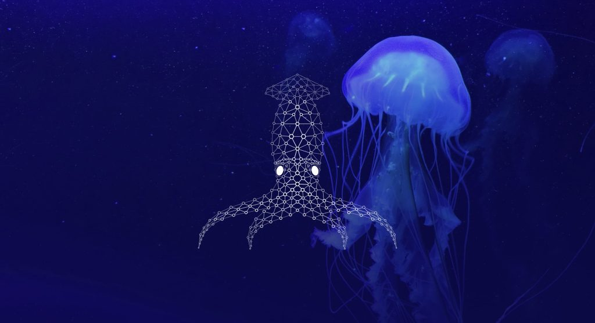
Sea Creatures
Detection

Slide 2

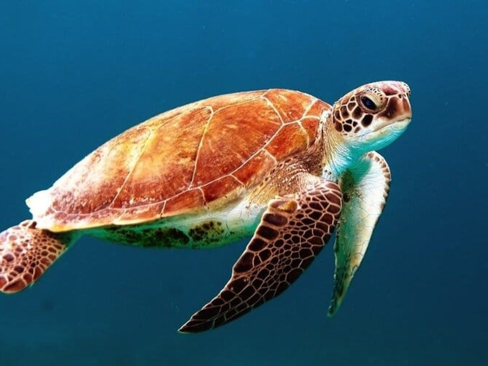

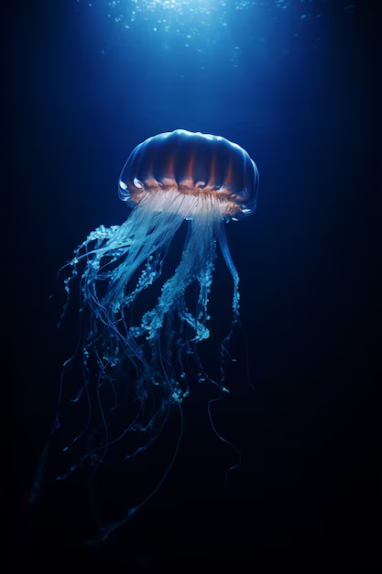
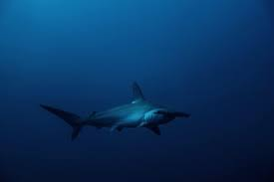
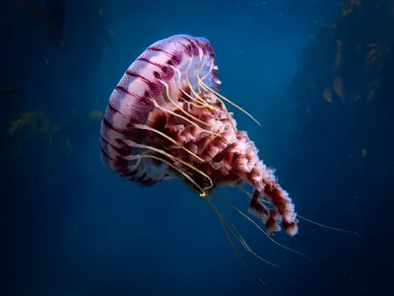
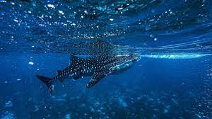
What Sea Creatures?
sea life is the collective all aquatic animals, single-celled microorganisms living in the saline water of marine habitats, either the sea water of marginal seas and oceans.

Slide 3
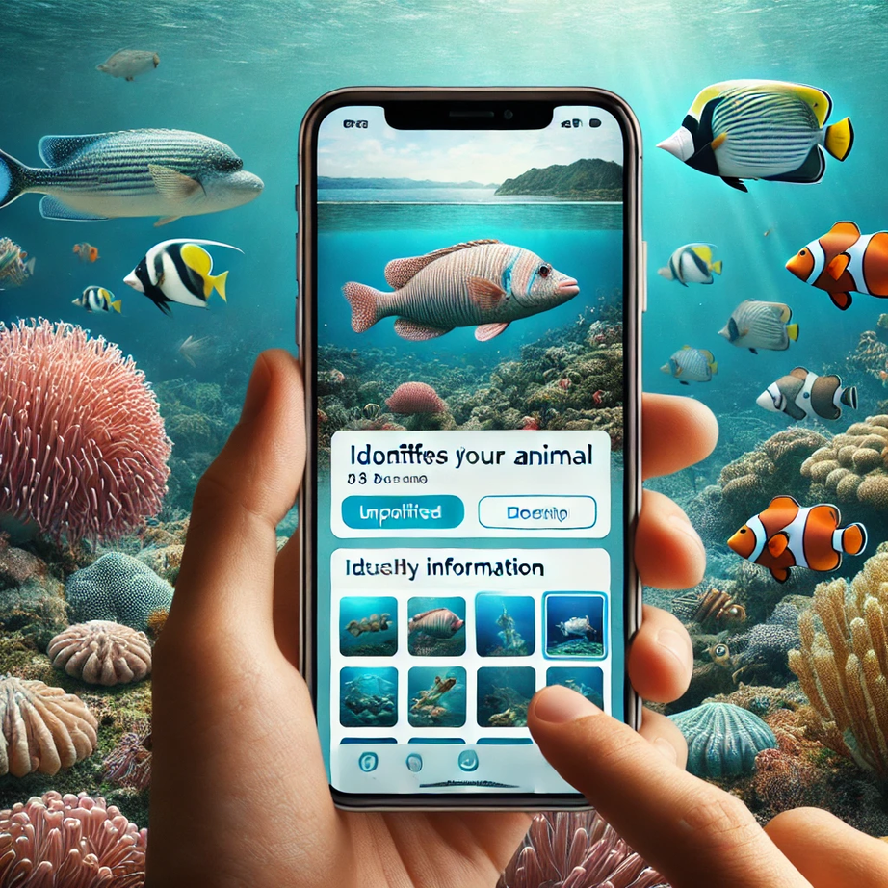
Why Sea Creatures?
Many people lack awareness of marine animals due to limited interaction with them.
However, some are genuinely interested 🔍 in marine life and eager to learn more about these fascinating creatures but may not know their names or details.
Additionally, there are divers 🏊‍♂️, whether for leisure or fishing 🚣‍♀️, who often encounter marine animals they cannot identify.
This project aims to help them learn about these creatures by simply uploading a photo. It also includes an educational component to enhance understanding of marine biodiversity.

Slide 4
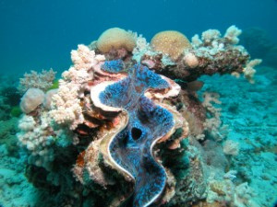
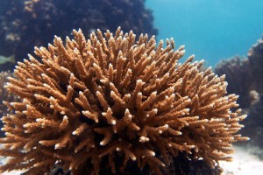
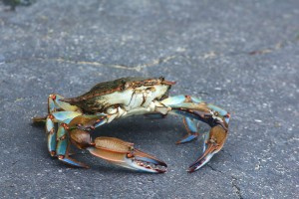
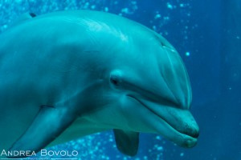
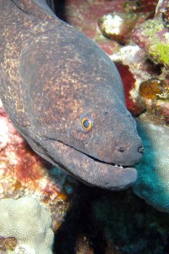
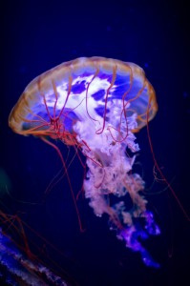
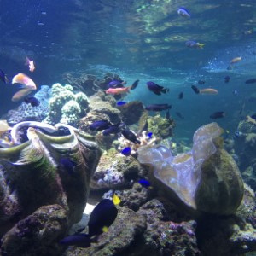
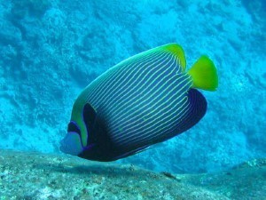
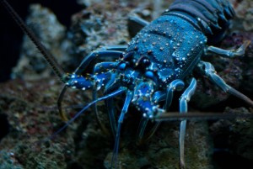
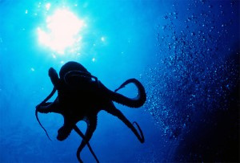
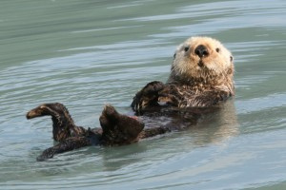
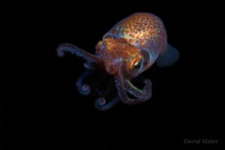
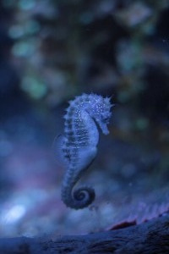
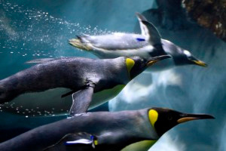
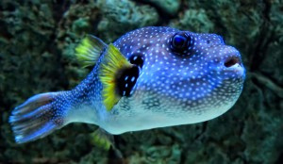
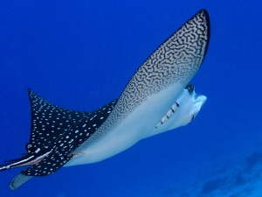
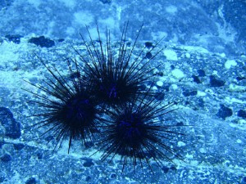
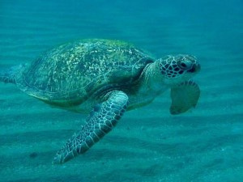
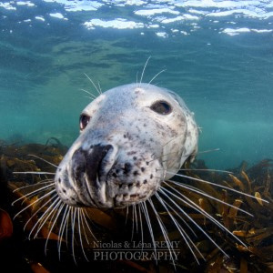
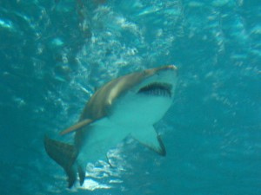
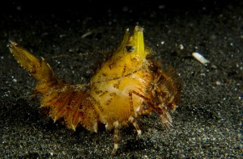
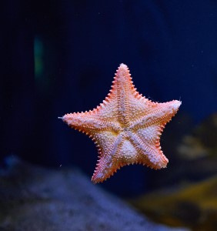
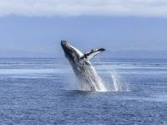
Description of Sea Creatures Dataset
The current version of the dataset has now 23 different Sea animal classes
Clams
Corals
Crabs
Dolphins
Eels
Jelly Fish
Nudibranchs
Fish
Lobster
Octopus
Otter
Penguin
Puffers
Squid
Rays
Sea Urchin
Seahorse
Seal
shark
Shrimp
Starfish
Turtle
Whales

Slide 5
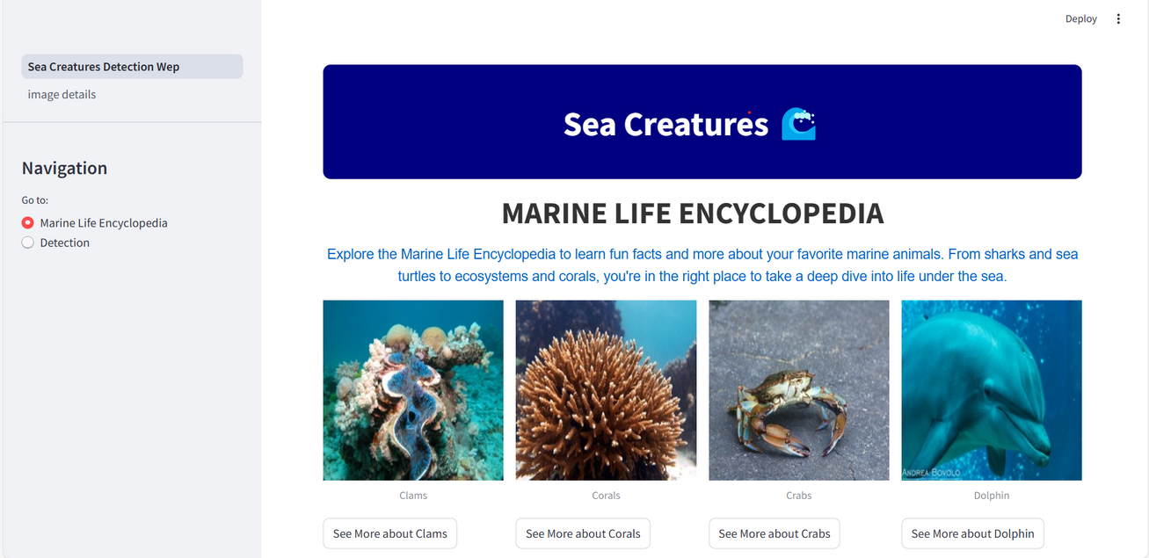
ففففف
Welcome to Our Web Application!
When you visit our platform, you'll be greeted with a fascinating collection of sea creatures🪸, complete with their names and images🐙🌊.
On the side, you'll find a user-friendly sidebar with two exciting options:
Marine Life Encyclopedia: Explore a curated list of animals with detailed information about each one, Engage kids with a fun and interactive quiz🪸.
Sea Creature Detection: straight into detecting an animal of your choice🔍.
Dive into the world of marine life with ease and enjoy a blend of education and discovery!

Slide 6
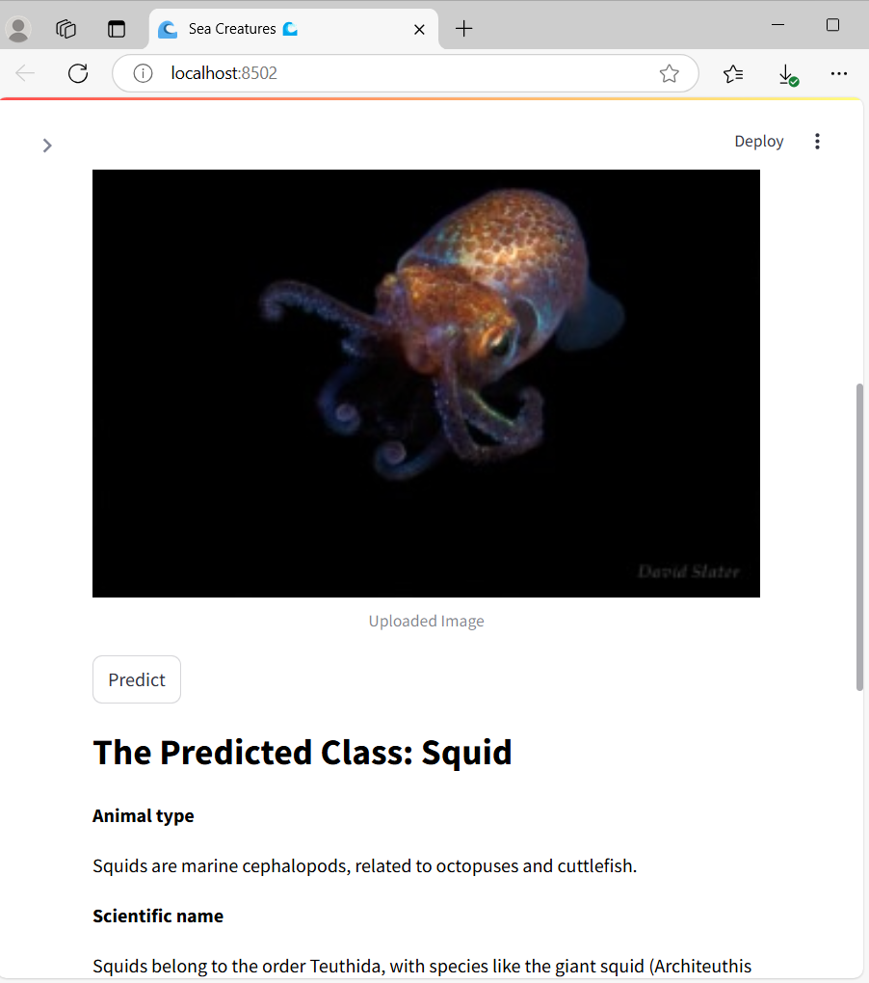
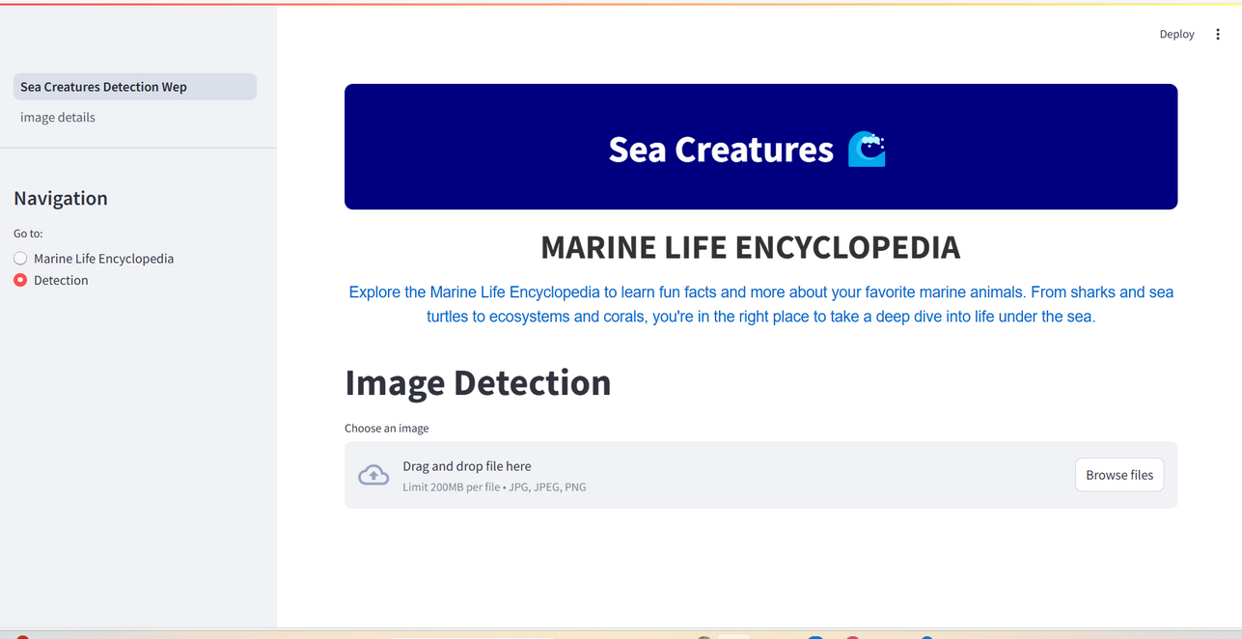
ففففف
Sea Creature Detection 🔍
In the Animal Detection feature, you'll be prompted to upload an image.
Once uploaded, a "Predict" button will appear.
Simply click it, and our system will identify the Sea creature in the image and provide detailed information about it🪸.
The result of predicted Animal 🎉

Slide 7
finally,
Are you a Whale 🐳?
Created by: Basant Saad Eldin

